Slide 1
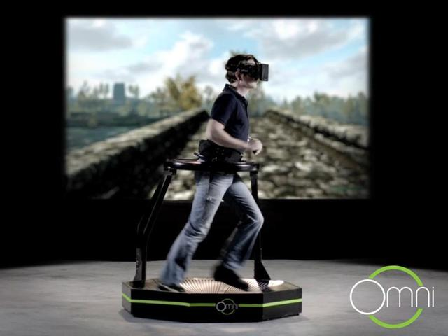

Project VIVAVOCE on Gesture Based Virtual Reality Systems.
Submitted By
SHYAM S (1041210549,Y4)
MOHAMMED SADIQUE G (1041210566,Y4)
GEETHA R (1041210579,Y4)
Under the guidance of
Mr.M.Maria Dominic Savio
Asst.Professor(O.G), Department of ECE, SRM University

Slide 2
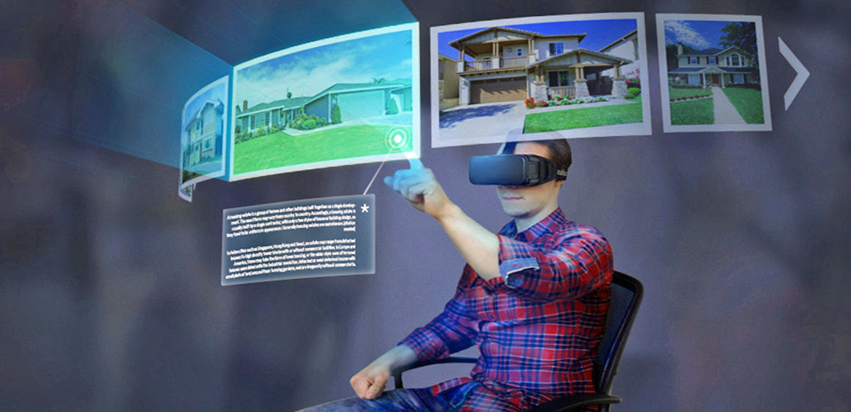
What is Virtual Reality ?
Virtual Reality (VR) is a computer simulated environment that has the inherent potential of manipulating people’s mind with a 3D experience using human image perception and optical illusions.

Slide 3

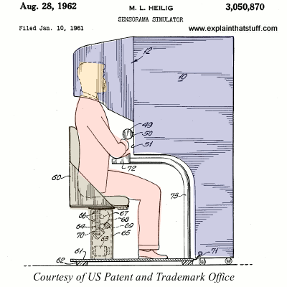
Introduction:
Virtual reality (VR) is process of completely knocking off user from the real environment and immerses them in a computer generated virtual environment.
It gives the user strong feeling of being present in that environment.
Virtual Reality is not new to us , It has been a dream for us for many years
Different scientist had different approach to virtual reality starting from Canaletto painting 250 years ago then to Thomas Alva Edison invention of camera in 1890 to Morton Heilig first head mounted 3-D display which gives artificial sensory experience which is called as Sensoram.
Now Oculus Rift developed a compact head mount VR head set which uses computer – graphics based system to provide 3-D interactive environment to the user
Virtual reality has a wide range of applications not only gaming and movies it can be used for educational , tourism , engineering and training for driving and shooting etc.

Slide 4
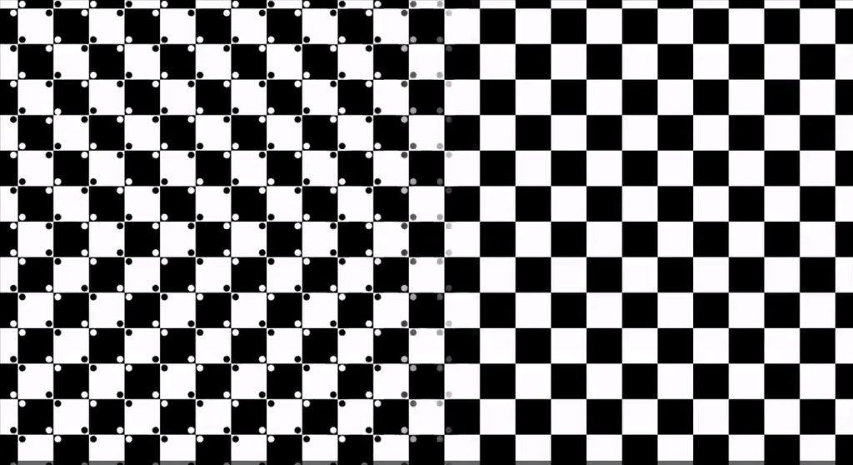
How it works ?
We don’t live the world of reality but live in the world of perceptions.
Virtual reality uses optical illusions to produce 3d effects to the user.
Here an example of a famous optical illusion is explained below.
This checkerboard looks curved/slanting until your eyes follow the lines from right to left and you'll realize the only difference are the black and white dots in each corner.
This optical illusion makes the image to look curved even though the original image is straight.

Slide 5
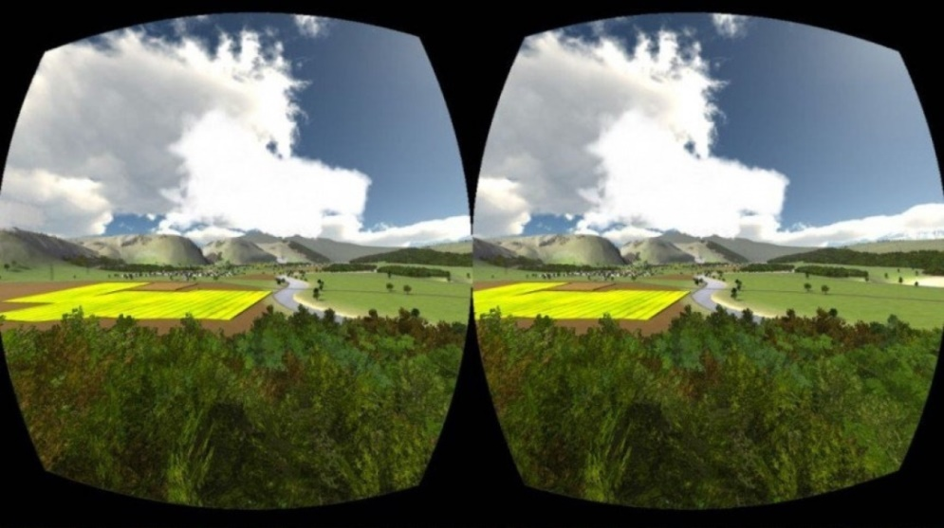
Optical illusion that is used in virtual reality is side by side illusion which shows the same image slightly different to both left eye and right eye separately.
The brain processes the image seen by both the eyes combines them to single image which gives the feeling of depth to the object of the image in the brain’s perceptive ,this gives the 3d effect to the user.
The side by side optical illusion is shown below.
This optical illusion along with the head tracking which is provided by the gyro sensor and accelerometer gives the user illusion of being present in that environment.

Slide 6
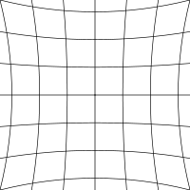
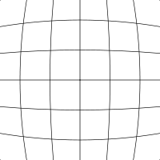
Geometric distortion is a common and important type of optical distortion that occurs in VR goggles as well as in other optical systems
Geometric distortion results in straight lines not being seen as straight lines when viewed through the goggle optics
The two common types of distortion are barrel distortion and pincushion distortion
Both these distortions are often radial, meaning that the amount of distortion is a function of how far a point is relative to the optical axis (e.g. the center of the lens system)

Slide 7
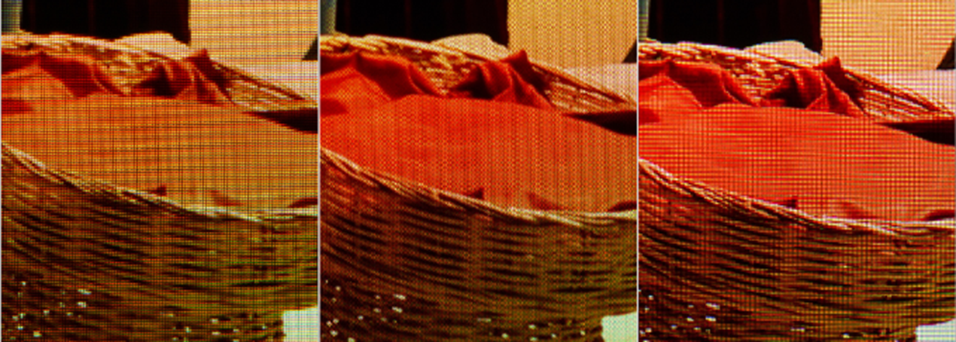
Comparison of various displays
1080p
1440p
2160p
There is also a problem called ‘Latency’ where the user tends to get disturbed by the delay in motion of the image/video displayed in the screen compared to the fast head movement of the user. This causes a severe problem as the users get disoriented and leads to dizziness.
This problem can be avoided by increasing the number of pixels and pixels per inch (ppi) in the display module
The number of pixels in the display module is very important for virtual reality. This is because the image displayed is zoomed by the convex lens present in the headset, so pixels look separated from others

Slide 8
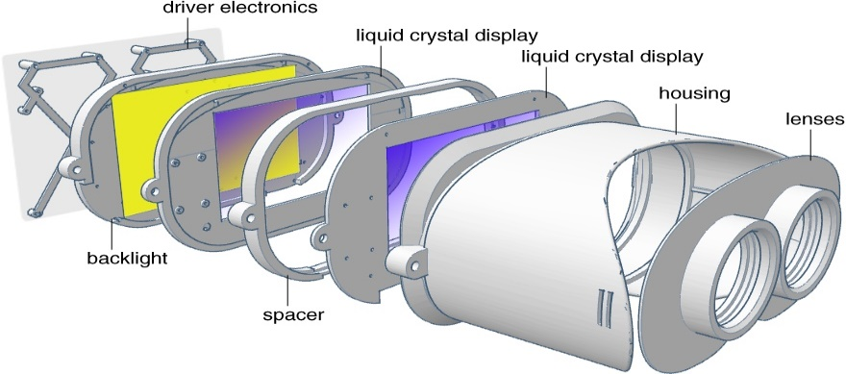
VR Existing system
The existing VR system uses a head mount displays (HMD)
The HMD works based on the principle where the lens is placed between our eyes and the pixels as the light from the display falls on the lenses and converges
Many sensors such Gyro sensor and Accelerometer are used to track the movements of the head and velocity of the movement respectively
Based on the values of Gyro sensor which depicts the position of the head with respect to x, y and z axes, the image is varied in the display screen, so that the user is able to venture into the virtual 3D environment.

Slide 9
FLOW CHART
User
Head movements tracking sensors
Hand Controller
Display Module
Simulator

Slide 10
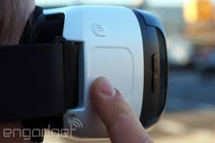
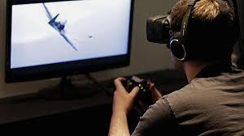
Problems in present VR:
VR can be used for various applications but this technology is out of reach for most of the people due to the high cost.
Cost of a high quality VR system is around Rs30,000/- to 40,000/-
Google card board box are cheap but they fail miserably in high graphics and gives a very low quality experience
The present virtual reality systems require very high processing power for high graphics , So high end processors are used which increases the cost to a very high value.
Also the present VR systems have a very complex controlling mechanisms.
The present VR either use joysticks or touch pads, controlling the VR systems using the joysticks/touch pads is very tough as we have to use them without seeing the joysticks/touch pads.
Controls using motion sensor is easier but motion sensors are very costly.

Slide 11
Proposed System
The existing system uses High end processors, sensors and two separate GPUs for providing Virtual Reality feeling to the users, this shoots up the cost of the VR system and makes it unaffordable
The main focus of this project is to provide a high quality and low cost virtual reality system
To reduce the cost without compromising on quality, Our Project will be using PC for processing along with dragon board 410c, which is the first development board based on a Qualcomm Snapdragon 400 series processor
To do the head tracking, we will be using the standard 6 axis mpu6050 sensors which are connected with dragon board 410c using Linux kernel for tracking movements of head

Slide 12
To improve the performance and also to reduce the cost , the computer is used for processing in case of high graphics as the computers are very common these days.
This can be done by using a separate interfacing circuit to connect to the computer directly with the display module
To reduces the complexity of user interaction by introducing hand gesture recognition technology using Arduino with flex and gyro sensors
The gesture recognition is achieved by placing the flex sensors on each finger of the gloves to recognize the position of the fingers and we also use the same gyro sensors mpu6050 to identify the arm movements
We are using 1080p TFT LCD display that refreshes at a rate of 60 Hz capable of refreshing the display at 60 fps and also has a wide angle display which uses an interface MIPI 4L 45-pin for pixel communication

Slide 13


Block Diagram
Head set
Interfacing circuit
1080p TFT LCD display module
Mixer
Dragon Board 410C(snapdragon processor)
Arduino Leonardo 1
Arduino Leonardo 2
Computer for high graphics
[optional]
Hand controller1
Hand controller2

Slide 14
Explanation
Headset
In the above block diagram, the upper portion within the dotted rectangular box represents the VR headset. The 1080p TFT LCD screen is placed inside the headset to which the image, video or application is supplied using an HDMI to MIPI 4L Interface card which is connected via the mixer.
The input to the Interface card is given using PC and another input comes from Dragon Board 410C processor board which contains a snapdragon processor which helps us for Head tracking application.
2. Gesture based hand controller
Pair of hand gloves, each with 5 flex sensors placed on each finger and a gyro sensor placed on the back of hand are employed. Each hand uses a separate Arduino board for itself which is programmed to perform the required hand control functions using ASCII value substitution.
3. Personal computer
Here we have used the PC to use all the software and applications available in the windows OS for virtual Reality. For the head tracking on PC side we have concentrated on the mouse control using the gyro sensor.

Slide 15
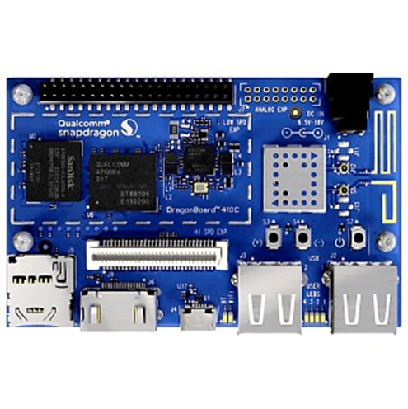
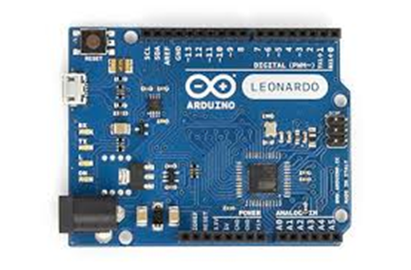
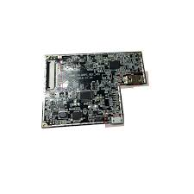
S.No | Apparatus Required | Images
1 | Dragon Board 410C
2 | Arduino Leonardo
3 | HDMI to 4L MIPI Interface Card

Slide 16
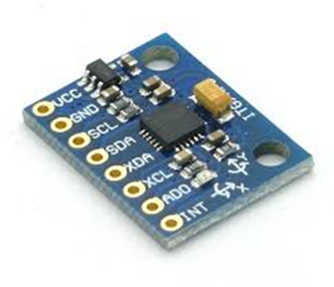
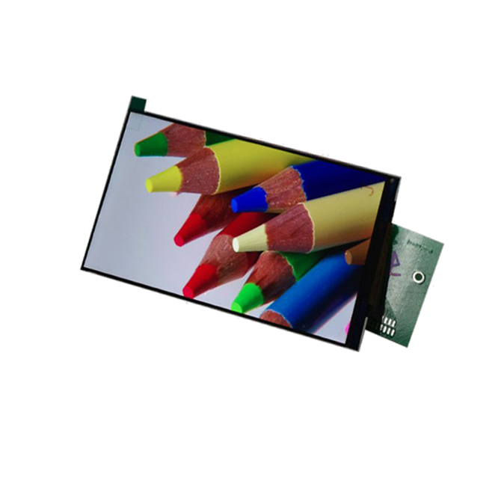
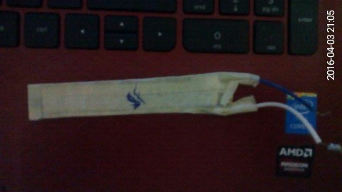
SNO | Apparatus Required | Images
4 | Gyro Sensor and Accelerometer Gy-521
5 | 1080p TFT 60Hz LCD Display Module
6 | Velostat Flex Sensor

Slide 17
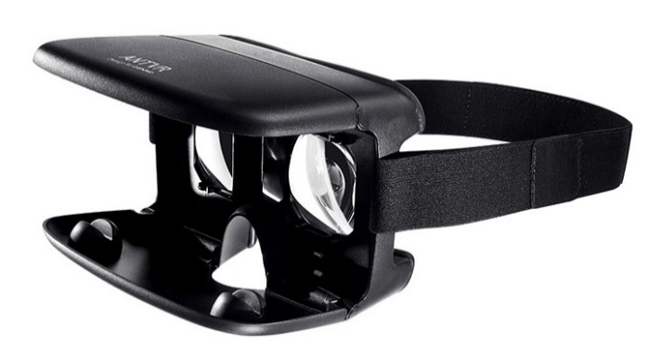
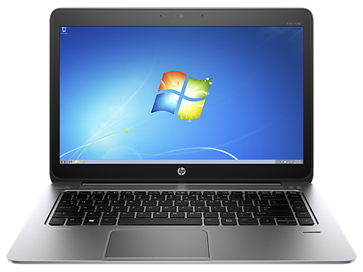
SNO | Apparatus Required | Images
7 | VR Headset
8 | Personal Computer

Slide 18
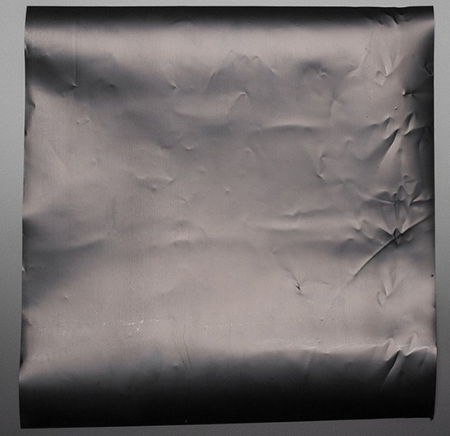
Low cost Flex sensor
Flex sensors are passive resistive devices that can be used to detect bending or flexing. It varies in resistance in accordance to the variation in bending. These are placed on top of each finger to detect their bending.
The sensors available in the market seem to be costly as each one costs around Rs.1500-2000. As the aim of this project is to be cost-effective, we opted to prepare our own low cost flex sensor which involves the following components
Black conductive film (Velostat)
Black conductive film (Velostat) is made of linear low density polyethylene to achieve high toughness and strength. The film is carbon loaded for consistent, non-humidity dependent conductivity

Slide 19
Aluminium Foil
Aluminum is an alloy of 98.5 percent aluminum and the rest being small amounts of tin and chromium. The thickness of foil ranges from the thinnest currently produced commercially at about 0.0065 mm (or 6.5 µm) to the defined upper limit of 0.2 mm (or 200 µm).
Masking Tape
Masking tape, also known as sticky tape, is a type of pressure sensitive tape made of a thin and easy-to-tear paper, and an easily released pressure-sensitive adhesive. It is available in a variety of widths. The adhesive is the key element to its usefulness, as it allows the tape to be easily removed without leaving residue or damaging the surface to which it is applied.
Resistor
Resistors are used here to create a variable voltage drop across the flex sensor which can be read in the microcontroller and processed to find the unknown resistor value. In this project, the resistors used are of the value of 1 kilo ohms (1 KΩ).

Slide 20
Preparation:
Cut the velostat with breadth of 0.8cm and height comfortable to each fingers as per requirement.
Cut two aluminum foils per finger with same dimensions of the velostat. Solder a thin wire at the end of the each aluminum foils. Cut masking tapes with breadth greater than the velostat and aluminum foil.
Paste the aluminum foil on the sticky side of the masking tape and make two of the same. Place the velostat in-between the two so that the aluminum foils and the thin wires are not in contact with the one at the other side. Now wrap up the sides of the two masking tapes.
Place a 1kΩ resistor at the middle of one of the wires. The resistor is placed to the gnd; the end of that wire gives the output value. The thin wire at the other end of the flex sensor acts as the Vcc

Slide 21
Comparison
Parameters | Present system | Our system
Processor | Octa-core processor (Exynos 7420 ) | Quad-core processor (Snapdragon 410C)
Graphical Processing Unit (GPU) | Two GPUs (Mali-T760 MP8) | One GPU (Qualcomm Adreno 306)
Sensors | 9-axis Gyro sensor , Accelerometer and Magneto meter | 6-axis Gyro sensor and Accelerometer
Controller | Touch pad , Joystick controller , Data gloves | Hand gesture recognition using Flex sensors and Gyro sensors
Auxiliary Interface Compatibility | Can’t interface with PC | Can Interface with PC
Cost | High cost (Rs 30,000 to Rs 40,000) | Low cost (Rs 8000 to Rs 10,000)

Slide 22
Software Description
Arduino:
Arduino is common development microcontroller used by students for developing project. Arduino is mainly used in Hand control for calibrating the values of Gyro sensor and flex sensor and using those for implementing gesture recognition and hand movement sensing which can be found helpful for creating user-friendly customizable controls for different applications and mouse control.
Lumion:
Lumion is software that used for every architect to create videos, images and 360 panoramas. By using this software in VR, the users can get into the virtual 3D world of their property before it is actually built in real life. It makes it helpful for builders and customers to perfectly plan and design, modify, decorate and perform interior designing in advance due to its life-like experience.

Slide 23
Linux Kernel:
The Linux kernel is a Unix-like computer operating system kernel.the Linux operating system is based on it and deployed on both traditional computer systems such as personal computer. While using Windows OS, Linux kernel programming helps to correlate movement of head with the mouse movement on the screen. While using Android OS, it is helpful in rendering the view of the user according to the movement of their head.
Tridef 3D:
It is an open source software which converts normal images, videos, games and applications into 3D format. The software also renders side-by-side viewing which is so essential for the user to experience VR. Apart from this, it also gives top-bottom view. These conversions are done by splitting the same display in two screens with each side slightly oriented towards their respective views to bring about a complete VR experience to the user.
Google Earth:
Google Earth is a virtual globe, map and geographical information program It maps the Earth by the superimposition of images obtained from satellite imagery, aerial photography and geographic information system onto a 3D globe.
Sweet FX
Sweet Fx is a open source software program code which is used to add effects to the software applications using this we can remove the distortions by applying barrel distortions to the image this gives 100% field of view to the user

Slide 24
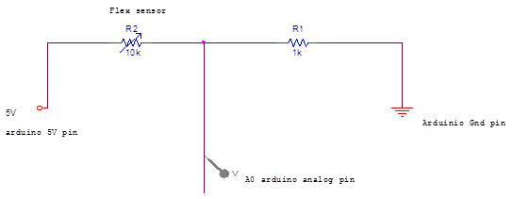
Designing:
The Arduino cannot read the resistance value directly, it can only read the voltage drop across the unknown resistance, so there should be a reference resistor connected in series with it to form a voltage divider circuit. Here the 1K ohm resistor acts as the reference which makes the voltage drop across the flex sensor variable in accordance with the value of resistance offered by the flex sensor. Then, as the bending of user’s finger causes some pressure on the flex sensor placed on the respective finger, the variation in resistance value is used for finding it for each position of fingers.

Slide 25
To find the unknown resistance
Program code:
…..int thumb = 0;
void setup()
{
Serial.begin(9600);
}
void loop()
{
thumb= analogRead(A0);
t= thumb * Vin;
Vout= (t)/1024.0;
t= (Vin/Vout) -1;
R2= R1 * t;
Serial.print("thumb finger \t");
Serial.println(R2);……..
This part of the program for the calculation of resistance of the flex sensor is done by using the formula of the resistors in series combination.
R₁ + R₂ =R
Current (I) will the same in a series circuit.
1/V = 1/V₁+1/V₂
V = I*R according to ohm’s law
We can get V1 from the Arduino using it we can calculate the V₂ value
1/V₂ = 1/V-1/V₁
The taken values from the sensor must be multiplied with V_{IN} 5v and divided by 1024 this is because maximum quantizing values for A/D converter is 0-1024.so this gives the voltage across the flex sensor
The unknown resistance can be found out by multiplying
R_{unknown} = R₁*(V_{IN}-V_{OUT}) /V_{OUT}

Slide 26
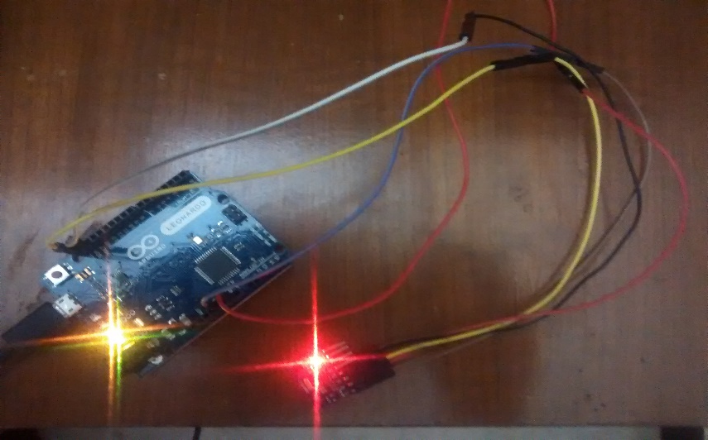
To Calibrate Gyro Sensor
In order to calibrate the gyro sensor should be connected to the Arduino Leonardo board by using SCL and SDA ports as this sensor uses I2C communication.
Once the sensor is connected the calibration program for the sensor must be uploaded and the offset values for the sensors must be calculated so the sensitivity of the gyrosensor is optimized
Once the sensor is optimized the values of yaw , pitch , roll used taken according to angle of the sensor orientation and tabulated.
so that sensor data can be used to find the orientation of the hand.

Slide 27
Parameter | deg | Ypr[0] | Ypr[1] | Ypr[1]
Zero state | nil | -21 | 2 | 7
Yaw | 45 | 33 | 4 | 12
 | 90 | 120 | 5 | 10
 | -45 | -81 | 7 | 12
pitch | 45 | -17 | 33 | 15
 | 90 | -18 | 82 | 19
 | -45 | -23 | -50 | 9
Roll | 45 | -20 | 8 | -42
 | 90 | -18 | 6 | -84
Calibration table for Gyro Sensor

Slide 28
ASCII value Substitution:
Keyboard and Mouse Control
From the above values of yaw, pitch and roll we can use these values in the ASCII substitution for mouse control and keyboard control for the gesture based hand controller. Also we can get the values from the flex sensor Using these values in the conditional statement, we can easily control the VR system using this below given program.
ALOGORITHM:
STEP 1: the values taken from Gyro sensor is converted to degree by using
a = ypr[1] * 180/M_PI;
STEP 2: Once the Value is converted the calibration table value and values from the flex senor is taken by the Arduino board and can be used for keyboard and mouse control by appling it in the conditional statement.
if (a<-15)
{….. }
For Keyboard control two functions in Arduino are used which is Keyboard.press(); this function press as if it is pressed for real will release it only after the KeyboardreleaseAll();
Keyboard.write(); is only for one instance press.
For mouse control main functions which is used is Mouse.Press(); to give mouse click effect and mouse.release(); to give the release button effect both right click and left click can be emulated.

Slide 29
STEP 4:for the moving the mouse pointer using the gyro sensor we are using the function Mouse.move(x,y,z)
x moves the mouse in x-axis
y moves the mouse in y –axis
z makes the scroll funition.
To avoid the unnesscesary mouse movements using gyro senors we must take differential of the gyro values and only move the mouse when change in value is very high.
The differential is done by taking values at different time period and compared.
a1 = time/1000;
time = millis();
if (a1%2!=0)
{ x=c;
}
if (a1%2==0)
{ y=c;
}
int z = x-y;
if (z!=0||z1!=0)
{Mouse.move(z,z1, 0);
delay(50);}
STEP 5: for Controlling the hand control ON/OFF a button is placed in the gloves with hand controller can be turned on/off

Slide 30
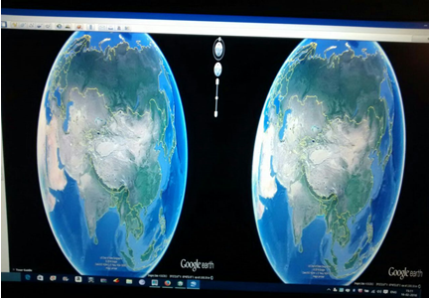
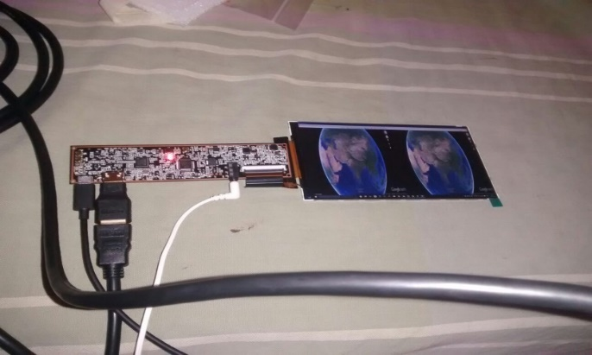
RESULT
The Virtual reality system is designed and number of applications has been successfully executed with it. By using the above system we were able to create the virtual environment and give a feeling of being visually present in that environment to the users.
We have used ‘tridef3D’ in Non VR software to convert them to side by side format so that it can be viewed in the virtual reality.
Google Earth is being displayed in the 1080p TFT display
Google Earth is being displayed in the 1080p TFT display
We Converted the Google earth which is non VR software. This can be used by for Tourisms and even for students when studying about a place. Our project gives the feeling to user for being present in that place itself

Slide 31
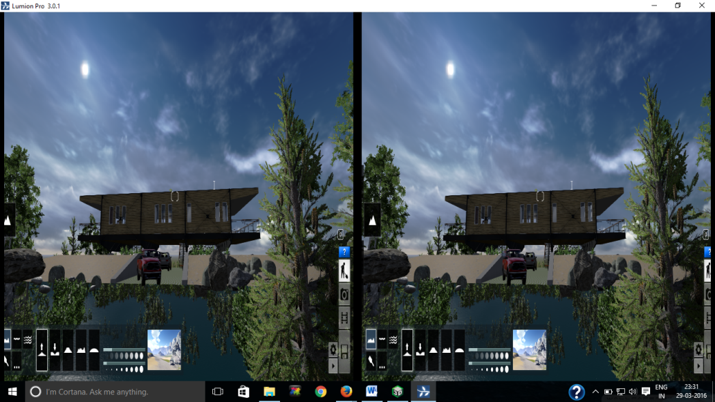
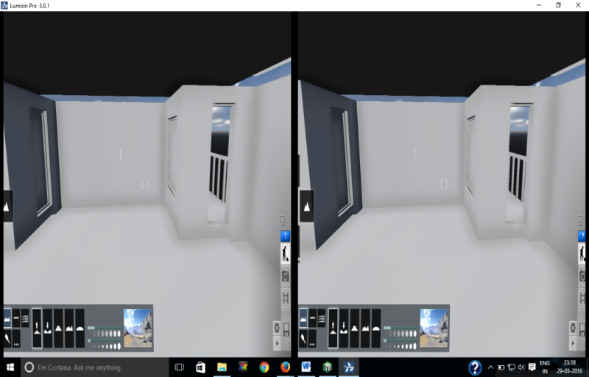
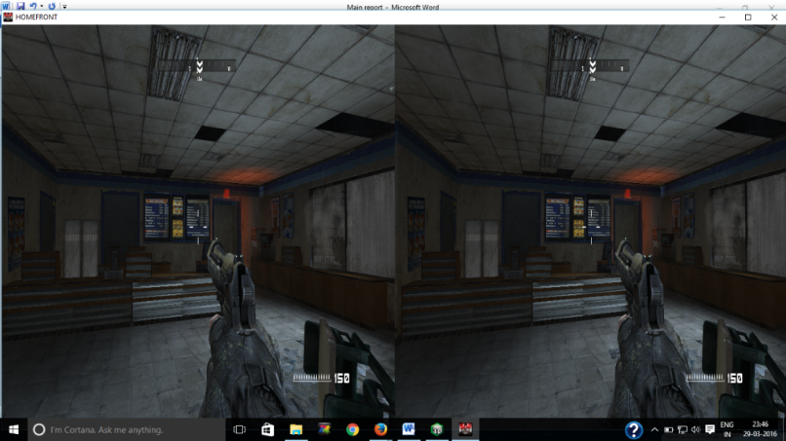
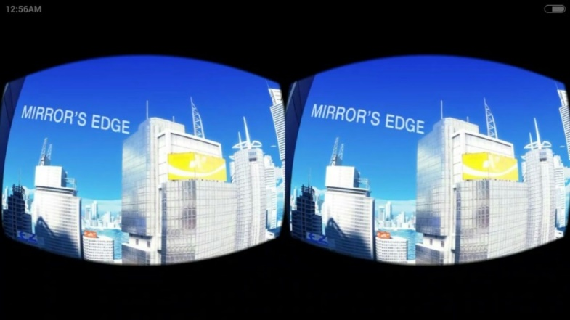
The lumion is a software which is by both civil engineers and real estate agents to convert CAD model plan for the house can be converted in to complete 3d model so now in people can see their house virtual reality just with a plan for that house. This will be very usefull for civil engineers and interior designers to view their design
We have also converted the traditional Non-VR shooting games to complete 3-d virtual reality which gives the user entertainment and it also can be used in gun shooting training given to individuals

Slide 32
REFERENCE
RiftSteven and M. LaValle and Anna Yershova and Max Katsev and Michael Antonov, Head Tracking for the Oculus,2014 IEEE International Conference on Robotics & Automation (ICRA),Hong Kong Convention and Exhibition Center, May 31 - June 7, 2014
S. A. Zekavat and R. M. Buehrer, Handbook of Position Location. IEEE Press and Wiley, 2012.
G. Welch and E. Foxlin, “Motion tracking: no silver bullet, but a respectable arsenal,” IEEE Computer Graphics and Applications, vol. 22, no. 6, pp. 24–38, 2002.
D. Titterton and J. Weston, Strapdown Inertial Navigation Tech-nology, 2nd ed. Institution of Engineering and Technology, Oct. 2004.
D. G.-E. and G. H. Elkaim, J. D. Powell, and B. W. Parkin-son, “Calibration of strapdown magnetometers in magnetic field domain,” Journal of Aerospace Engineering, vol. 19, no. 2, pp. 87–102, 2006.
M. Abrash, “Latency: the sine qua non of AR and VR,” Dec. 2012. [Online]. Available: http://blogs.valvesoftware.com/abrash/latency-the-sine-qua-non-of-ar-and-vr/
J. Carmack, “Latency mitigation strategies,” Feb. 2013. [Online]. Available: http://www.altdevblogaday.com/2013/02/22/latency-mitigation-strategies/

Slide 33
